Slide 1
Machine Learning Prediction
Student’s Adaptability Level In Online Education

Slide 2
Business Problem
The present study is an opportunity to expand on this by investigating the role of adaptability in assisting students’ online learning experiences and outcomes during a period of substantial novelty, variability, and uncertainty—specifically, online learning during the COVID-19 pandemic.
A chain of educational institutions record a data from students of different schools and universities to understand how much students are adapting the online education.
Data are collected here are student’s information on three levels schools, colleges and universities.
Adaptability is the capacity to adjust, understand and react on questions.
Business Objective
Objective is to understand the relationship between different factors which will affect the online learning learning system.
And Prediction on Student's Adaptability Level in Online Education.

Slide 3
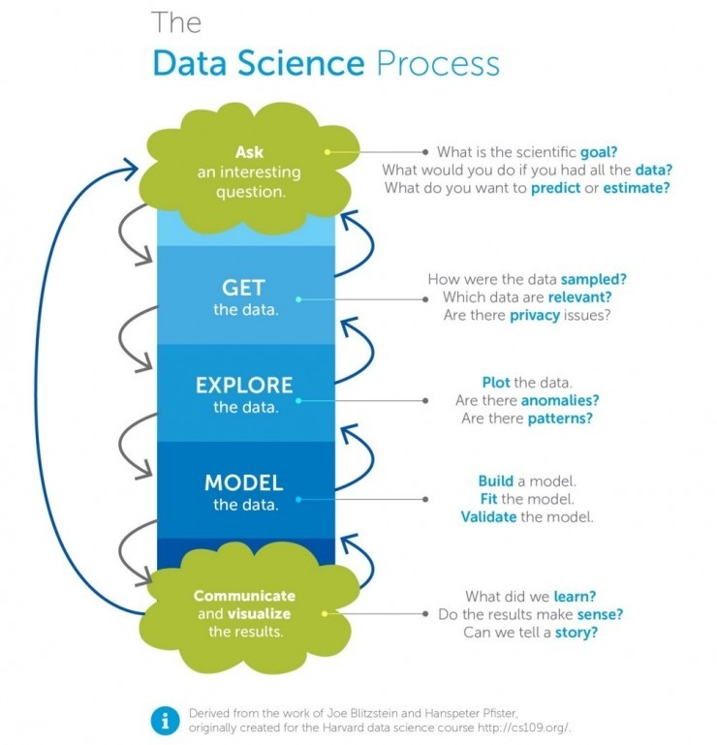
Project Flow

Slide 4
Dataset Detail
File Name | students_adaptability_level_online_education
File Type | csv
Feature Names | Gender, Age, Educational Level,Institution Type,IT Student, Location,Load Shedding, Financial condition of a family,Internet Type, Network Type , Class Duration,Self LMS,Device,Adaptability Level.
Data Shape | (1205, 14)
Null Values | No null values
Duplicate Values | No null values
Data Type | No null values
Missing Values | No missing values

Slide 5
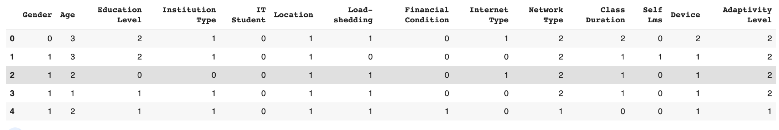
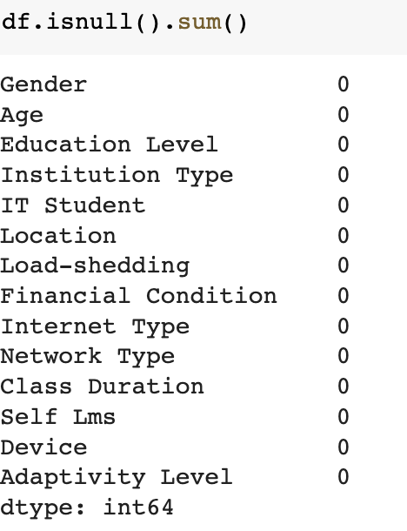
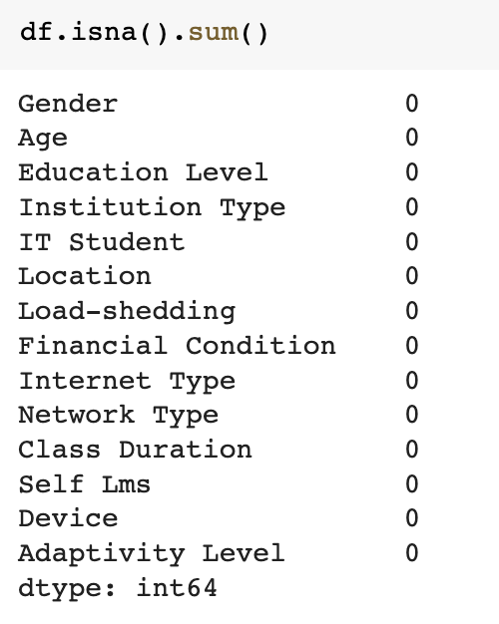
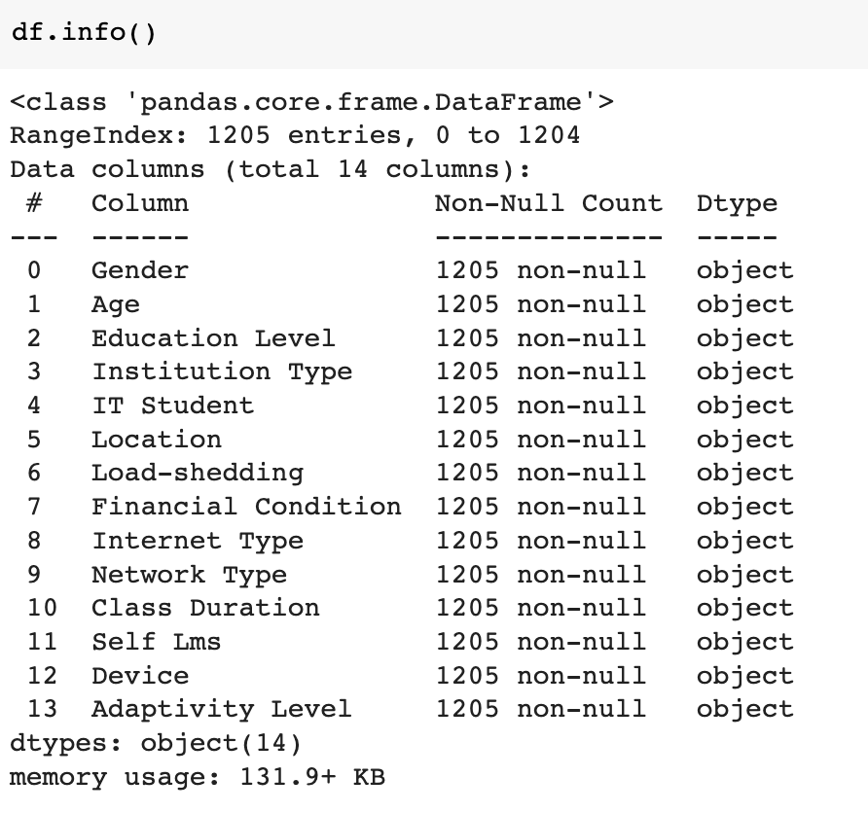
Data Set details

Slide 6
EDA(Exploratory Data Analysis)
EDA
Univariate data analysis
Multivariate data Analysis

Slide 7
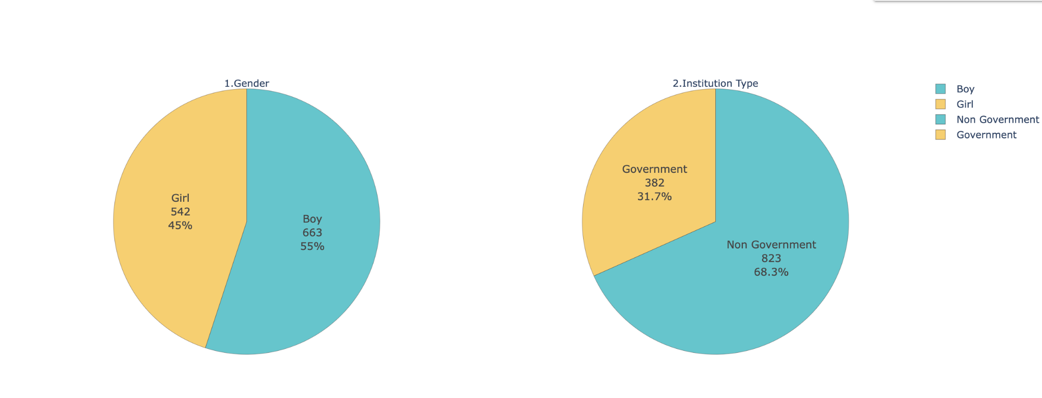
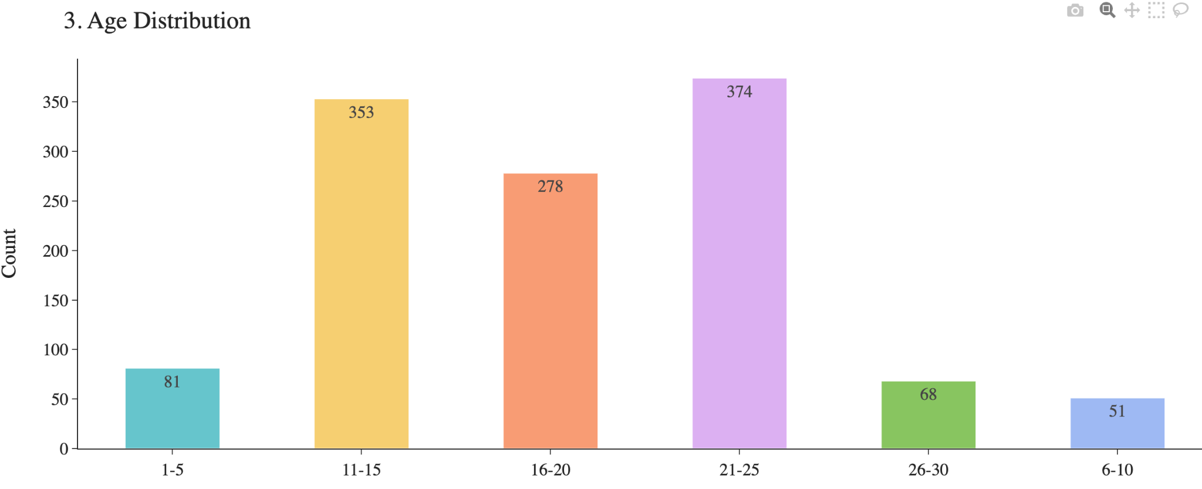
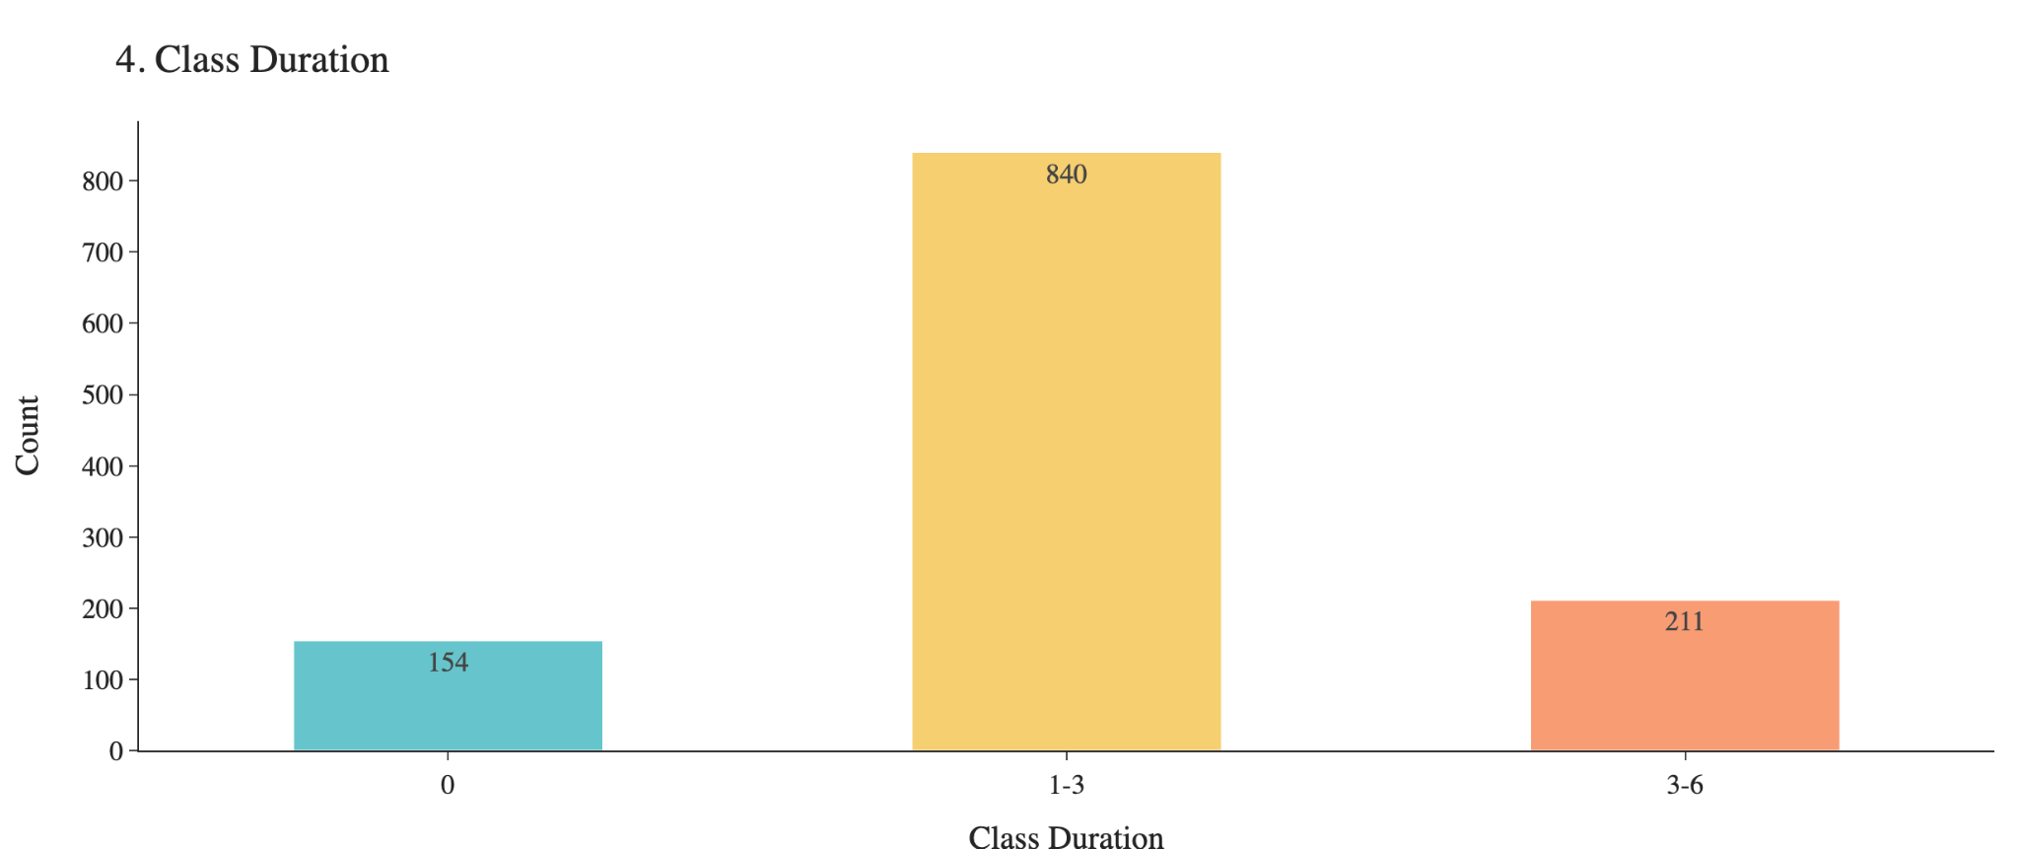
EDA(Univariate Analysis)
Gender VS Institution Type
From this chart we can see that we have 45% girls and 55% boys data in which 31.7% are studying in government institution and 82.3% are studying in Non government institution.
Age vs Class duration
Age Of the respondents is mainly distributed between 11 and 25.Class Duration mainly distributed between 1-3 hrs

Slide 8
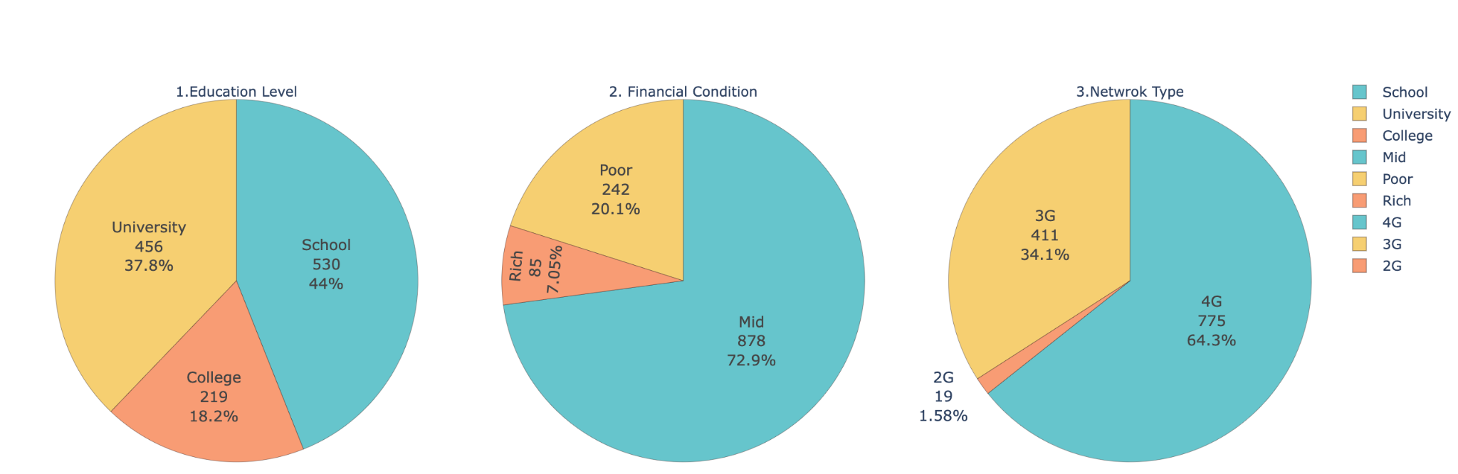
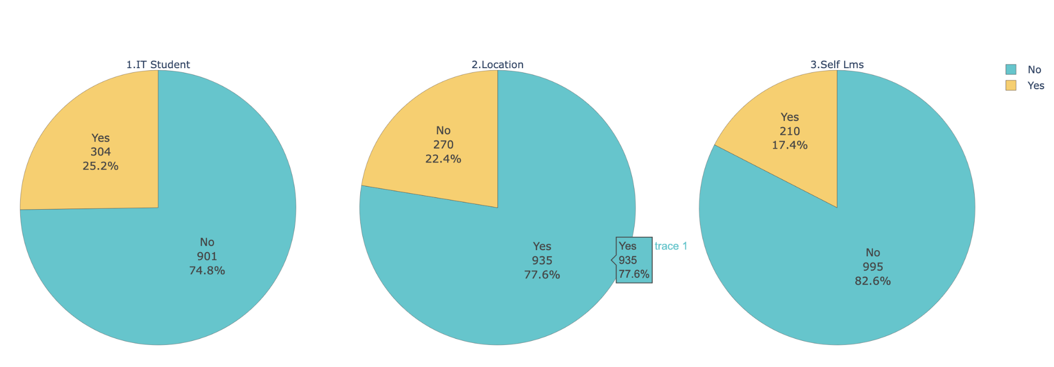
EDA(Univariate Analysis)
Most of the respondents attend School and University
And most of them are situated in Mid financial condition
There are just 1.58% of students using 2G network
About 25.2% of respondents are studying as IT student.
And 77.6% of them are located in town.
Furthermore, 17.4 of their instructions own LMS availability.

Slide 9
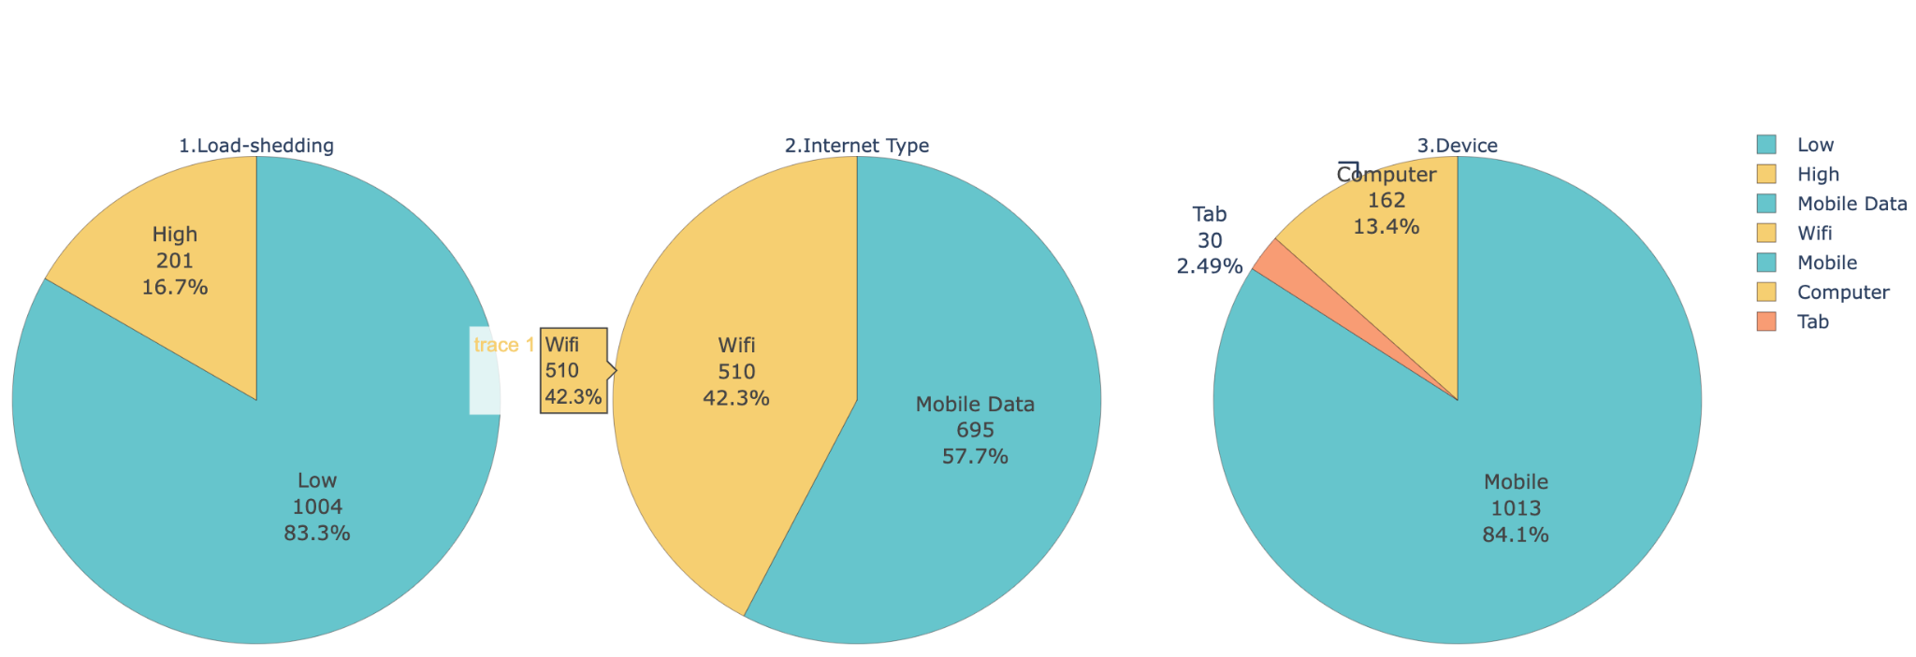
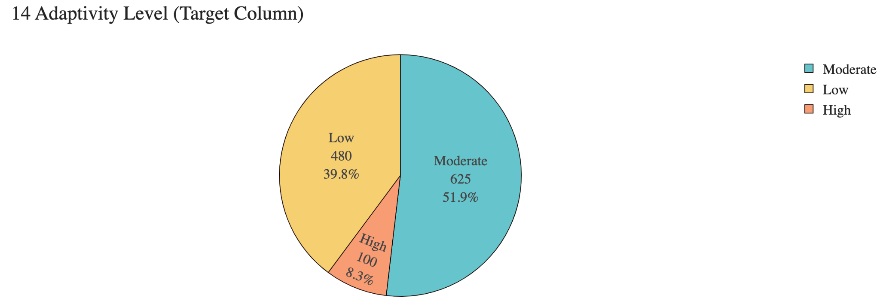
EDA(Univariate Analysis)
Load-shedding refers to level of load shedding, and type 'low' account for 83.3%.
57.7% of respondents use mobile data to take online classes.
84.1% students uses mobile to take online class
Adaptability level which is our target column refer to adaptability level of the student during online education.
It can be seen that about 51.9% respond they have moderate adaptability, while low accounts for 39.8% and high the rest.

Slide 10
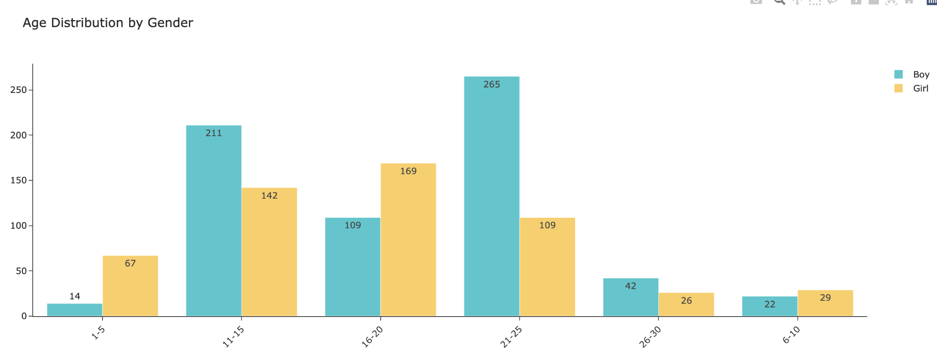
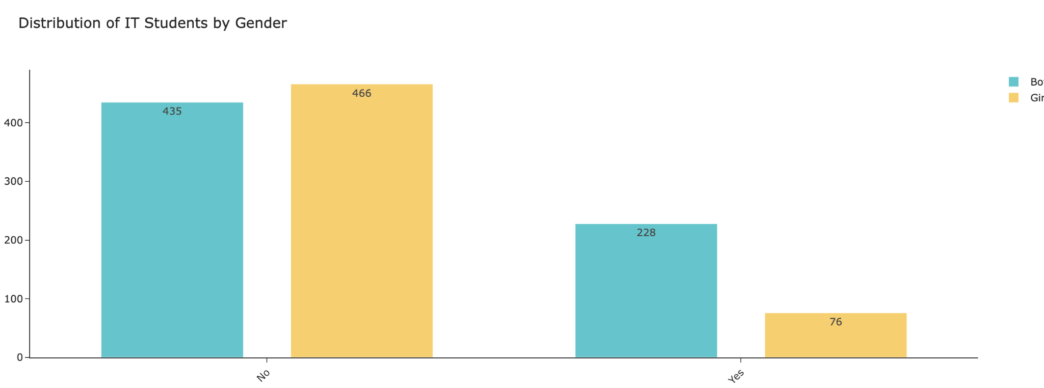
EDA(MultiVariate Analysis)
Female's age mainly distributed in 11-20 while age of male mostly distributed between 11-15 and 21-25
Here we can notice that male tend to study as IT student compared to female.

Slide 11
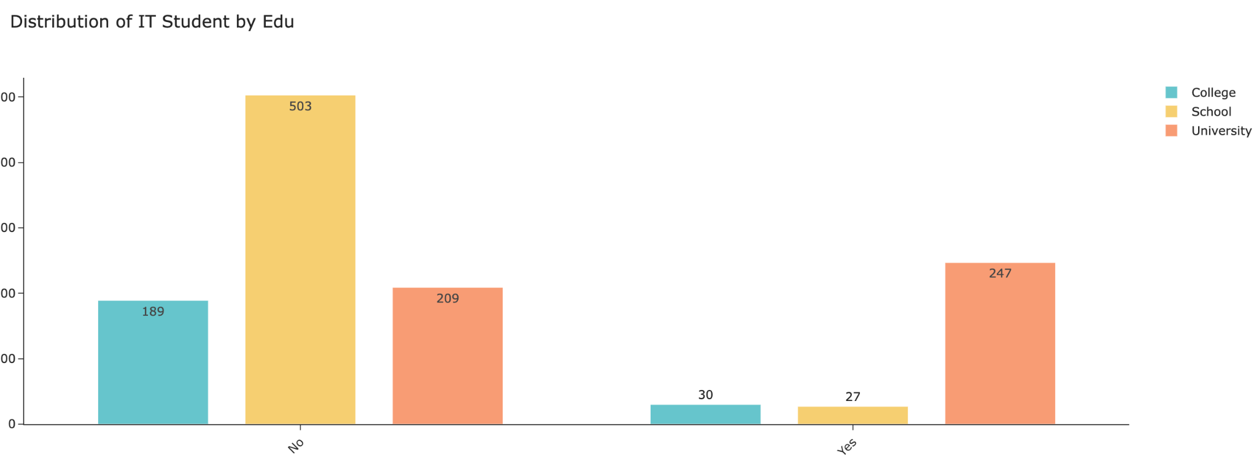
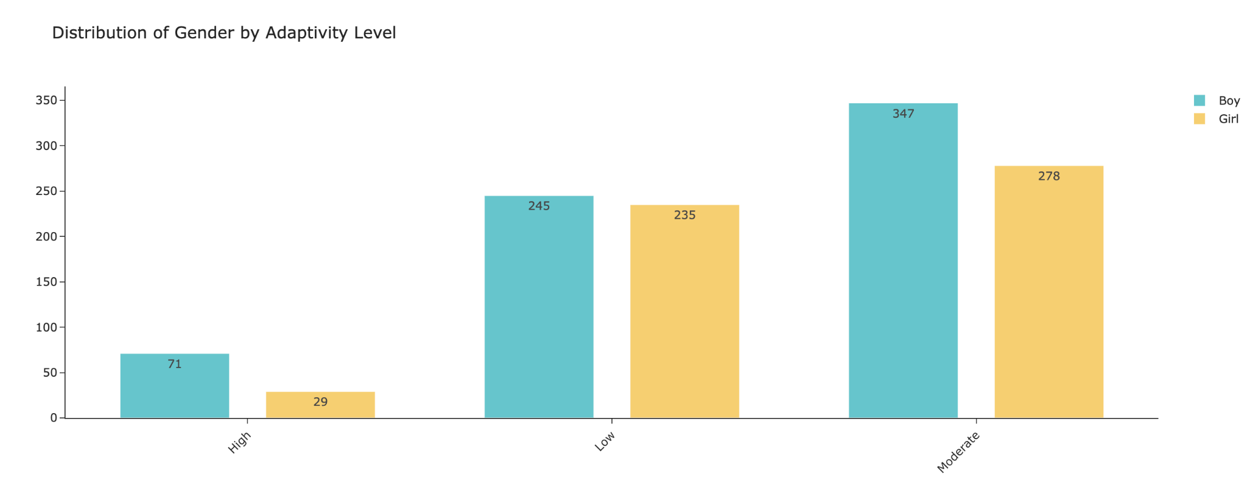
EDA(MultiVariate Analysis)
It is obvious that university got the most IT students, whereas 30 and 27 IT students in college and school.
In the survey, 71 male respondents answered as they have high adaptivity level in online education compared to 29 female.
Additional, both male and female overall got moderator adaptivity level.

Slide 12
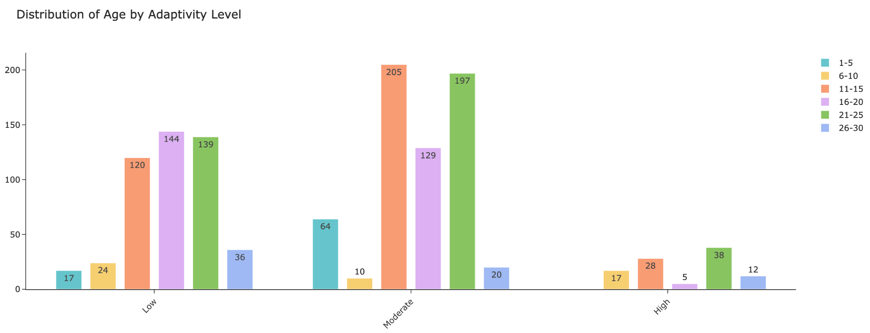
EDA(MultiVariate Analysis)
11-15, 21-25 and 26-300 relatively got high adaptivity level while obvious that none of 1-5 got high adaptivity

Slide 13
Model Building
Once we are done with the data analysis part we will work on our model building part where we will select only those models which will work well on our related dataset. As per our business problem we have to go into detail understanding of each model how they are working and how they are going to help us in getting best Mean Accuracy score.
Totally we have built 5 machine learning models and 1 Deep learning model evaluated those model results using the Mean Accuracy score. Some of the prominent models we built are
LogisticRegression
KNearest
RandomForestClassifier
XGBClassifier
CatBoostClassifier
ANN

Slide 14
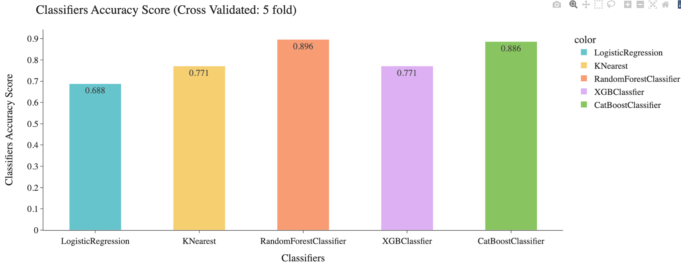
Model Evaluation
Mean Accuracy Values before applying OPTUNA hyperparameter Tuning arguments to our models.OPTUNA works for Random Forest Classifier and Cat Boost Classifier.
Model | Mean Accuracy Score
LogisticRegression | 68.809%
K Nearest Neighbour | 77.112%
RandomForestClassifier | 89.568%
XGBClassifier | 77.107%
CatBoostClassifier | 88.619%
ANN

Slide 15
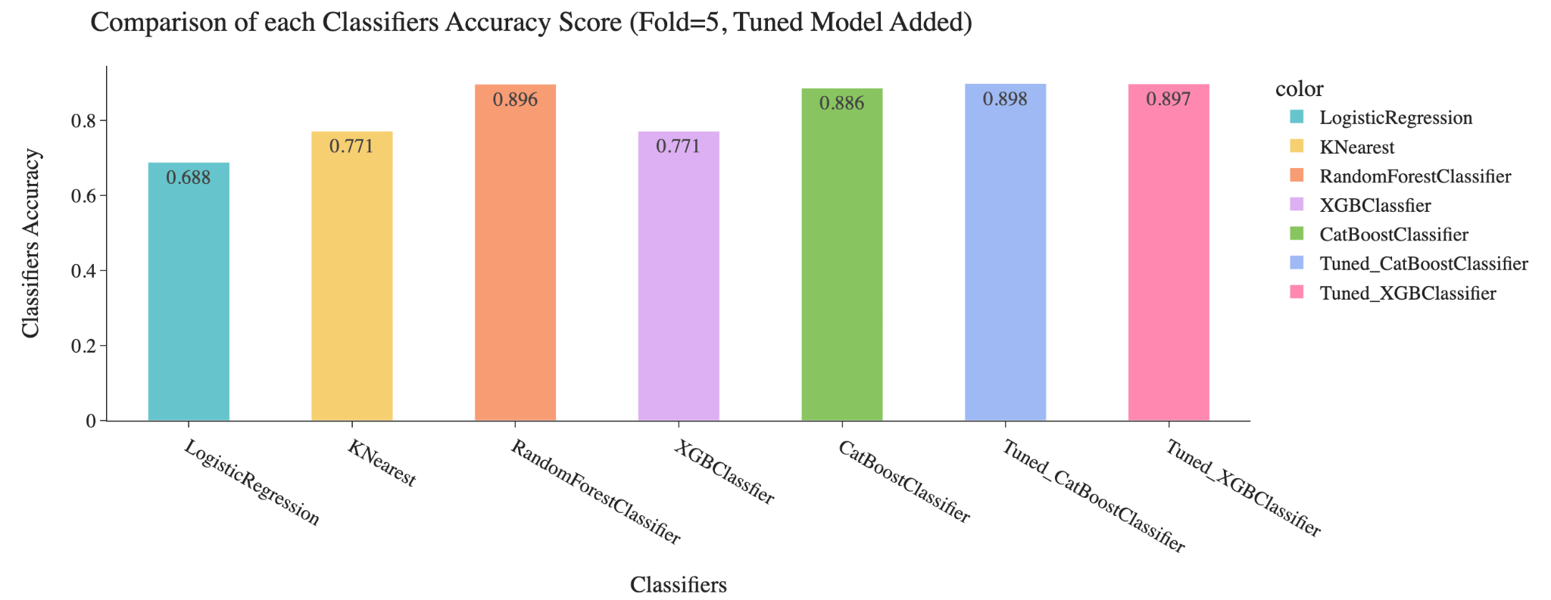
Model Evaluation
Mean Accuracy Values after applying OPTUNA hyperparameter Tuning arguments to our models.OPTUNA works for Random Forest Classifier and Cat Boost Classifier.
Model | Mean Accuracy Score
LogisticRegression | 68.809%
K Nearest Neighbour | 77.112%
RandomForestClassifier | 89.568%
XGBClassifier | 89.7%
CatBoostClassifier | 89.8%
ANN | 88.02 on train data 83.977% on test data

